Slide 1
Unit 8
Is there a post office near here?
Section A Grammar Focus-3c
七年级(下)

Slide 2

Objectives
To learn to ask and answer Where questions
To learn to write sentences using prepositions of place

Slide 3

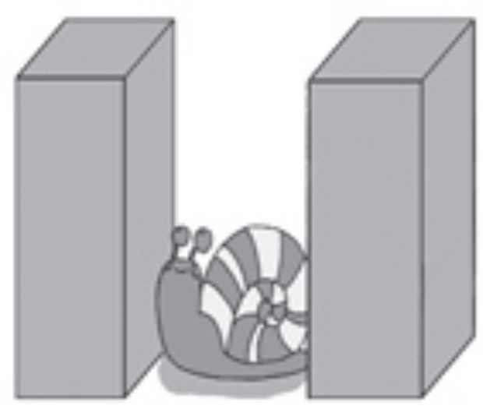

1. The snail (蜗牛) is _________ the two
boxes.
2. The snail is _____________ the box.
between
in front of

Slide 4

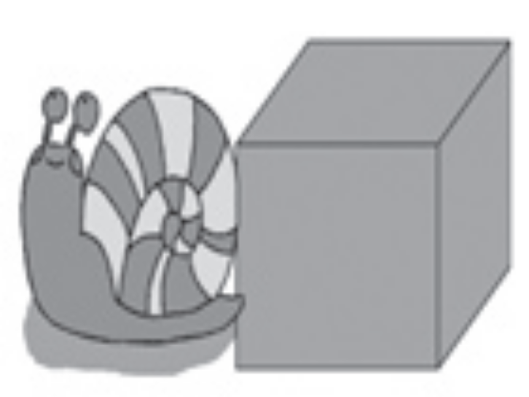

3. The snail is ________ the box.
4. The snail is _________ of the box.
5. The snail is __________ of the box.
behind
on the left
on the right

Slide 5
Grammar Focus
Is there a bank near here? | Yes, there is. It’s on Center Street.
Are there any restaurants near here? | Yes, there’s one in front of the post office.
Where’s the hotel? | It’s behind the police station.
Where’s the bank? | It’s next to the post office.
Where’s the park? | It’s across from the bank, behind the hotel.
Where are the pay phones? | They’re between the post office and the library.

Slide 6
阅读Grammar Focus部分，
完成下列句子。
1. 附近有银行吗？_________________________________
2. 是的。它在中心街上。
_________________________________
3. 附近有餐馆吗？
_________________________________
Is there a bank near here?
Yes, there is. It’s on Center Street.
Are there any restaurants near here?

Slide 7
有，在邮局前面有一家。
___________________________________
___________________________________
旅馆在哪里? ___________________
6. 它在公安局后面。_________________________________
Yes, there’s one in front of the post office.
Where’s the hotel?
It’s behind the police station.

Slide 8
7. 银行在哪里? __________________
8. 它紧挨着邮局。
_____________________________
9. 公园在哪里？__________________
10. 它在银行对面，旅馆后面。 ____________________________________
11. 投币电话在哪里？
_____________________________________
12. 他们在邮局与图书馆之间。 _________________________________________
Where’s the bank?
It’s next to the post office.
Where’s the park?
It’s across from the bank, behind the hotel.
Where are the pay phones?
They’re between the post office and the library.

Slide 9
探究乐园
There be 句型
一、There be ...句型表示的是“某处有(存
在) 某人或某物”，其肯定句结构：
1. There be (is，are) +名词+地点状语
e.g. 在我的铅笔盒里有两块橡皮。
_____ ___ two erasers in my pencil box.
在房子前有一棵大树。
_____ __ a tall tree in front of the house.
There are
There is

Slide 10
2. 否定句：There isn’t / aren’t…
e.g. 大桥街上没有银行。
_____ _____ a bank on Bridge Street.
在教室里没有篮球。
______ _____ any basketballs in the
classroom.
There isn’t
There aren’t

Slide 11
3. 一般疑问句：Is/ Are + 主语 +…?
肯定回答：Yes, there is/are.
否定回答：No, there isn’t/aren’t.
e.g. 这附近有餐馆吗？
__ _____ a restaurant near here?
教室里有学生吗？
___ _____ any students in the classroom?
Is there
Are there

Slide 12
二、There be 句型中的主谓一致原则
There be句型中be动词的形式要和其后面的主语在人称和数上保持一致。
(1) 如果句子的主语可数名词的单数，
或是不可数名词，be动词用“is”。
e.g. 紧挨着邮局有一个投币电话。
_____ __ a pay phone next to the post
office.
There is

Slide 13
(2) 如果句子的主语是复数名词，be动
词就用“are”。
e.g. 在公园里很多树。
_____ ____ many trees in the park.
There are

Slide 14
(3) 如果有两个或两个以上的名词作 主语，be动词要和最靠近它的那个主 语在数上保持一致，也就是我们常说 的“就近原则”。
在桌子上有一个桔子和一些香蕉。
_____ __ an orange and some bananas
on the table.
在桌子上有一些香蕉和一个桔子。
_____ ___ some bananas and an
orange on the table.
There is
There are

Slide 15
三、There be 句型与have的区别
There be句型表示 “存在”，have\has表示 “拥有”、 “所有”，两者不能同时使用。
桌子上有一架模型飞机。
_____ __ a model plane on the desk.
我有一架模型飞机。
_ _____ a model plane.
There is
I have

Slide 16
探究乐园
where 引导的特殊疑问句
where是特殊疑问词, 含有“哪里, 某地”
的意思。一般用来询问地点。
where 引导疑问句时, 主谓要求倒装, 且助
动词必须与后面的主语保持一致。
Where’s the park ? It’s on Center Street.
Where are the books ? They are on the desk.

Slide 17
Where do you live ? I live in Changsha.
Where does he live ? He lives in Mexico
City.
例如：
Where is he? He is in the classroom.
他在哪里？他在教室里。
Where is he from? He is from England.
他来自于哪里？他来自英国。

Slide 18
根据划线部分提问。
(1) John is from America.
(2) Lucy is in the office.
解析: (1)是指John 来自美国。因此用
Where… from进行提问。
(2)是指Lucy在办公室。因此只用where提问。
答案 (1) Where is John from?
(2) Where is Lucy?

Slide 19
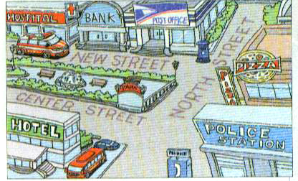
Look at the map and answer the questions.
3a

Slide 20
1. Where is the bank?
_____________________________________
2. Is there a restaurant on North Street?
_____________________________________
3. Where’s the pay phone?
_____________________________________
4. Where’s the post office?
_____________________________________
5. Is there a hospital near the pay phone?
______________________________________
It’s between the hospital and the post office.
Yes, there is.
It’s next to the police station.
It’s next to the bank, across from the hotel.
No, there isn’t. There’s one on New Street.

Slide 21
Look at the map in 3a and write
three sentences.
3b
1. The bank is next to the hospital and across from the park.
2. ____________________________________
____________________________________
3. _____________________________________
The park is between Centre Street and New Street.
There is a restaurant on North Street.

Slide 22
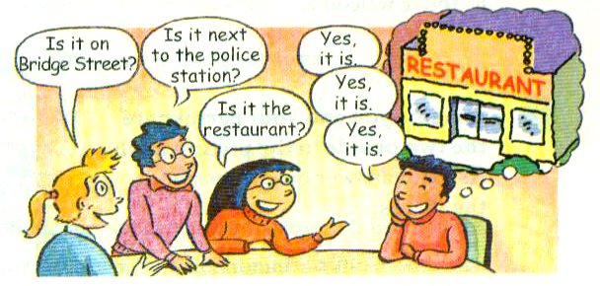
Game
Take turns to choose a place in the picture in 1a on Page 43. Your
classmates ask questions and then
guess the place.
3c

Slide 23
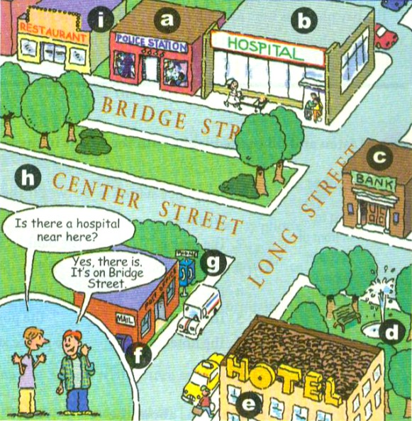
A: Where is the hospital? Is it on
Bridge Street?
B: Yes, it is.
A: Is it next to the police station?
B: Yes, it is.
A: Is it between the hotel and the
bank?
B: No, it isn’t.

Slide 24
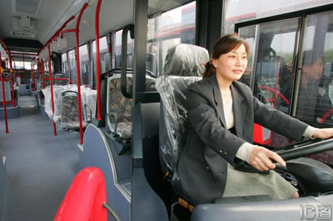
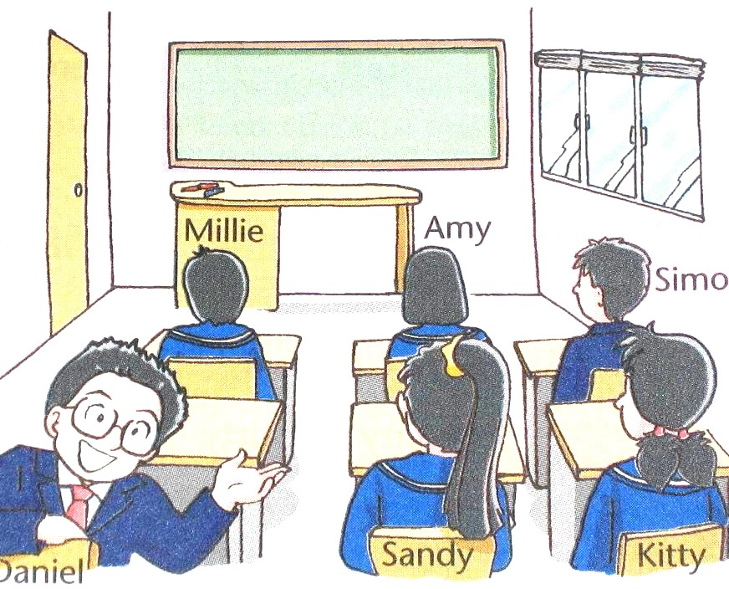

Practice
根据图片提示补全对话。
—Where ___ the driver?
—She is _____________ the bus.
is
in the front of
—Where is Kitty?
—She sits ________ Sandy.
.
next to
Is there
—___ _____ a beside table in
the bedroom?
—Yes, _____ __. It’s ________
the bed.
there is
next to

Slide 25
language points
1. next to 接近, 邻近(近义词near) 例如：
It is next to/near the hotel.
它邻近宾馆。
He is standing near/next to his father.
他站在他父亲旁边。

Slide 26
链接: next to 的同义词是beside, 意为
“在(某人或某物)旁边”。例如：
She sits beside me. = She sits next to me.
near 也有表示在某物的附近, 意为“靠近,
接近”。如：
The football is near the door.
足球在门旁边。

Slide 27
near 除了作介词表示方位外, 还可以作形
容词，意思是“近的, 不远的”, 其反义词是
far, 意为“远的，遥远的”。例如：
My home is very near from my school.
我家离学校很近。

Slide 28
2. in front of… 在……的前面
反义词
opposite word
behind
in front of the post office
behind the post office
in front of the supermarket
behind the supermarket
in front of the library
behind the library
邮局前/后
超市前/后
图书馆前/后

Slide 29
区别in front of 和 in/at the front of
A
A is in front of B.
B
B
A
A is in/at the front of B.

Slide 30
3. across from 介词词组, 意为“在……的对面”。
如：We live across from the street.
我们住在街道的对面。
在英语中, “在……的对面”还可以用其他的短
语表示, 例如：
1) The bus stop is on the other side of the river.
汽车站在河对面。
2) The fruit shop is opposite the post office.
水果店在邮局对面。

Slide 31
4. between 介词, 表示“在……中间”, 常与
and 连接, 构成短语。例如：
I sit between Lucy and Lily.
我坐在露西和莉莉中间。
among 也表示“在……中间”, 但是between
是指在两者之间, 而 among 是指在三者或
三者以上的中间。例如：
My brother is among those boys.
我哥哥在那群男孩中间。

Slide 32
School Park Zoo
Bridge Street
Supermarket Bank
The supermarket is on ______ ______.
The zoo is ______ _______ the bank.
The park is _______ the school ____ the zoo.
Bridge Street
across from
between
and

Slide 33
5. left
这个词有三种词性, 既可做形容词、副词,
还可做名词。
1) 作形容词时, 用来修饰名词，意思是
“左边的，在左边的”。
例如：
The pay phone is on the left side of the
supermarket.
公用电话在超市的左边。

Slide 34
2) 作副词时, 用来修饰动词, 意思是“向
左”。
例如：
Go down to the end of the road and then
turn left.
沿着这条路走到底再向左转。
3) 作名词时, 意思是“左侧, 左方”。
例如：
Come and sit on my left.
来, 坐在我的左边。

Slide 35
链接: right 是left的反义词, 其用法和left
一样。on the left / right (side ) , on one’s left
/ right 这些词组常用在问路和指路的句型
中。例如：
— Excuse me. Is there a bank in the
neighborhood ?
—Yes, there is. It’s down Bridge Street on
the right.
The restaurant is ___ the left.
A. in B. at C. on
C
解析: on the left / right 是固定词组。

Slide 36
6. Excuse me. 对不起，打扰了。
常用来表示打扰他人、不同意、迫不得已
而失礼时的道歉。例如：
Excuse me, may I borrow a pen, please ?
对不起, 我可以借支钢笔吗？
Excuse me, which is the way to the bus
stop ?
对不起, 请问汽车站怎么走？

Slide 37
链接: “I’m sorry.” 也是“对不起”的意思,
但它常用于做错了事之后或不能满足对方
的要求时, 表示歉意。
如：May I come in, please ? I’m sorry
I’m late.
请问我可以进来吗？对不起，我迟到了。

Slide 38
7.在英语中,“问路”的说法有很多种,例如：
Excuse me. Where is the pay phone ?
Excuse me. How can I get to the library ?
Excuse me. Can you tell me how to get to the
library ?
Excuse me. Can you tell me the way to the
library ?
Is there a library near here/around here/in
the neighborhood?

Slide 39
Answering the way:
1. Go straight ( until the end ).
2. Go down/along Bridge Street.
3. Turn left/right.
4. Go across the street.
5. It’s down/along New Street on the left/
right.
6. Turn left/right at the first crossing.
7. Take the first turning(转弯处)on the
left/right.

Slide 40
8. You’re welcome. 不客气, 不用谢。
这是当对方道谢时的回答语。
You’re 是You are 的缩略形式。例如：
--Thank you very much.
--You are welcome.
链接: 回答thank you的用语还有：
That’s all right. 不用谢。
That’s OK. 不用谢。
Not at all. 没关系, 不用谢。

Slide 41
Review
课时重点回顾
Where’s the bank?
It’s next to the post office.
Where’s the park?
It’s across from the bank, behind
the hotel.
Where are the pay phones?
They’re between the post office and the library.
-Is there …?
-Yes, there is one …/No, there isn’t.

Slide 42
Exercise
根据汉语提示完成句子。
1. 火车站在公园对面。
__________________________________
2. 餐馆紧挨着邮局。
__________________________________
3. 在银行前有一个投币电话。
______________________________________
4. 在医院后面有一个公园。
_________________________________
5. 在公安局附近有一个超市吗？
______________________________________
The train station is across from the park.
The restaurant is next to the post office.
There is a pay phone in front of the bank.
There is a park behind the hospital.
Is there a supermarket near the post office?

Slide 43


Homework
Look at the map in 3a, write more sentences according to the example in 3b in your book.

Slide 44
Thank You!

